Slide 1
Amazon Athena
Lecturer: Ngo Huy Bien
Software Engineering Department
Faculty of Information Technology
University of Science
Ho Chi Minh City, Vietnam
nhbien@fit.hcmus.edu.vn

Slide 2

Objectives

Slide 3

Contents

Slide 4

References

Slide 5
Amazon Athena
https://aws.amazon.com/athena/
Amazon Athena is a serverless, interactive analytics service built on open-source frameworks, supporting open-table and file formats.
Athena provides a simplified, flexible way to analyze petabytes of data where it lives.
Analyze data or build applications from an Amazon Simple Storage Service (S3) data lake and 30 data sources, including on-premises data sources or other cloud systems using SQL or Python.
Athena is built on open-source Trino and Presto engines and Apache Spark frameworks, with no provisioning or configuration effort required.

Slide 6
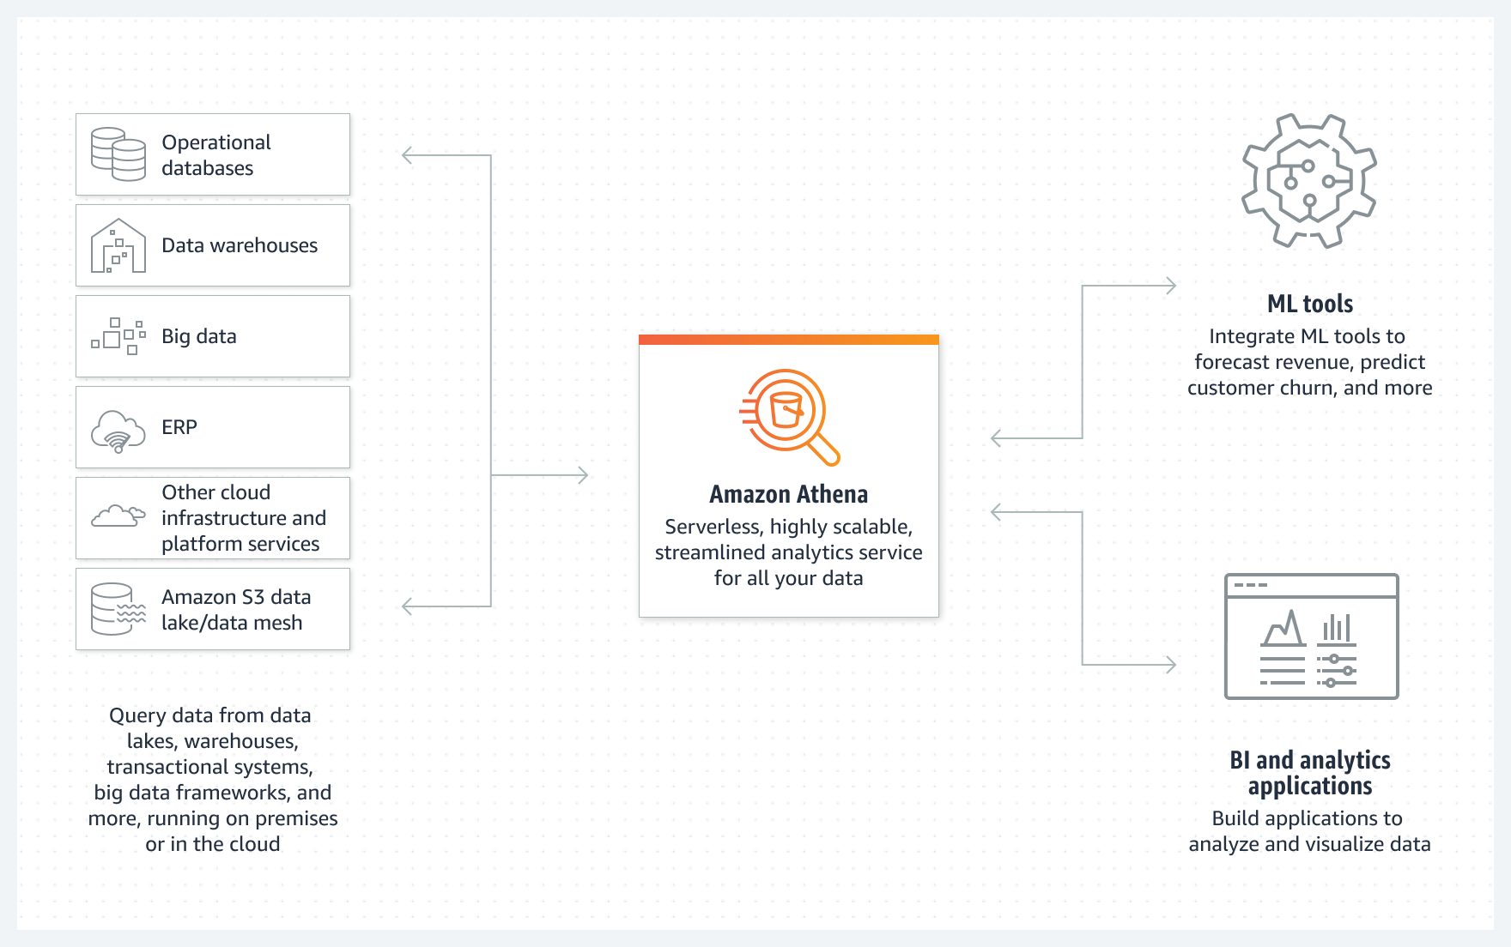
How Amazon Athena Works

Slide 7
Use Cases
Run queries on S3, on premises, or on other clouds.
Prepare data for ML models.
Build distributed big data reconciliation engines.
Perform multicloud analytics.

Slide 8


Slide 9
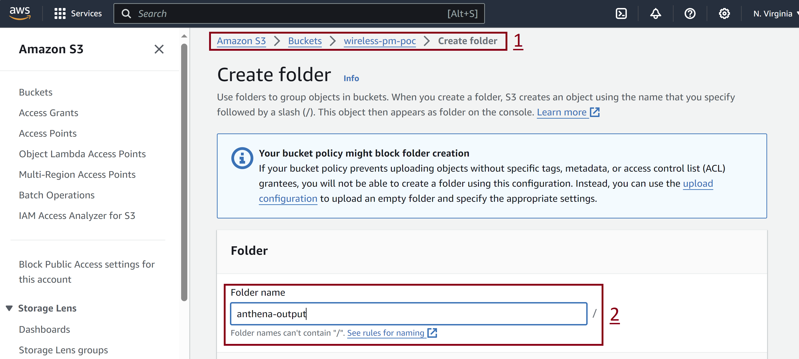
1. Create S3 Folder for Query Output

Slide 10
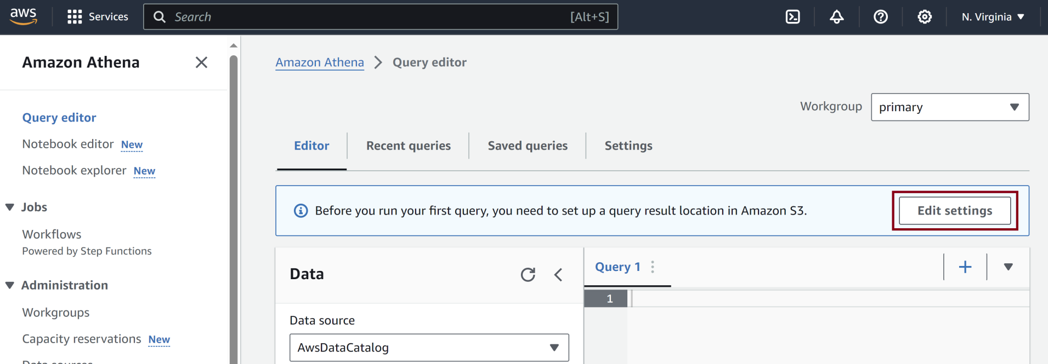
2. Configure Query Output Location

Slide 11
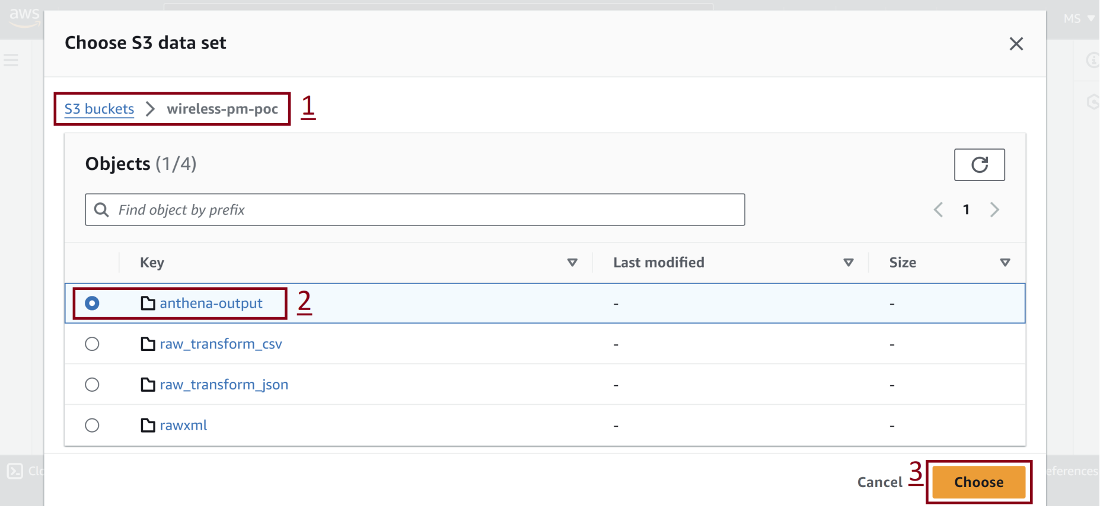
3. Select S3 Folder

Slide 12
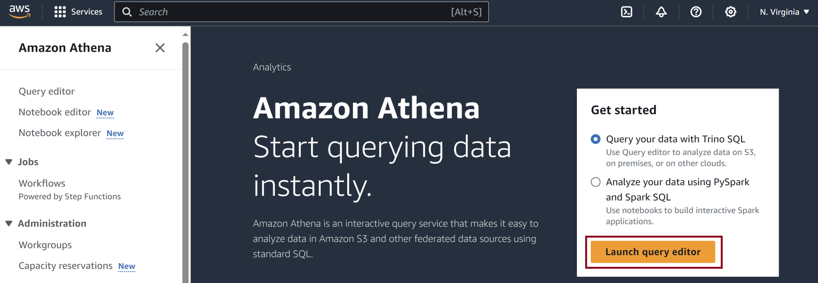
4. Create Query

Slide 13
Example Query
select "fh_fs_element_type", "md_mi_meas_name", "md_mi_meas_value" from "raw_transfrom_csv"

Slide 14
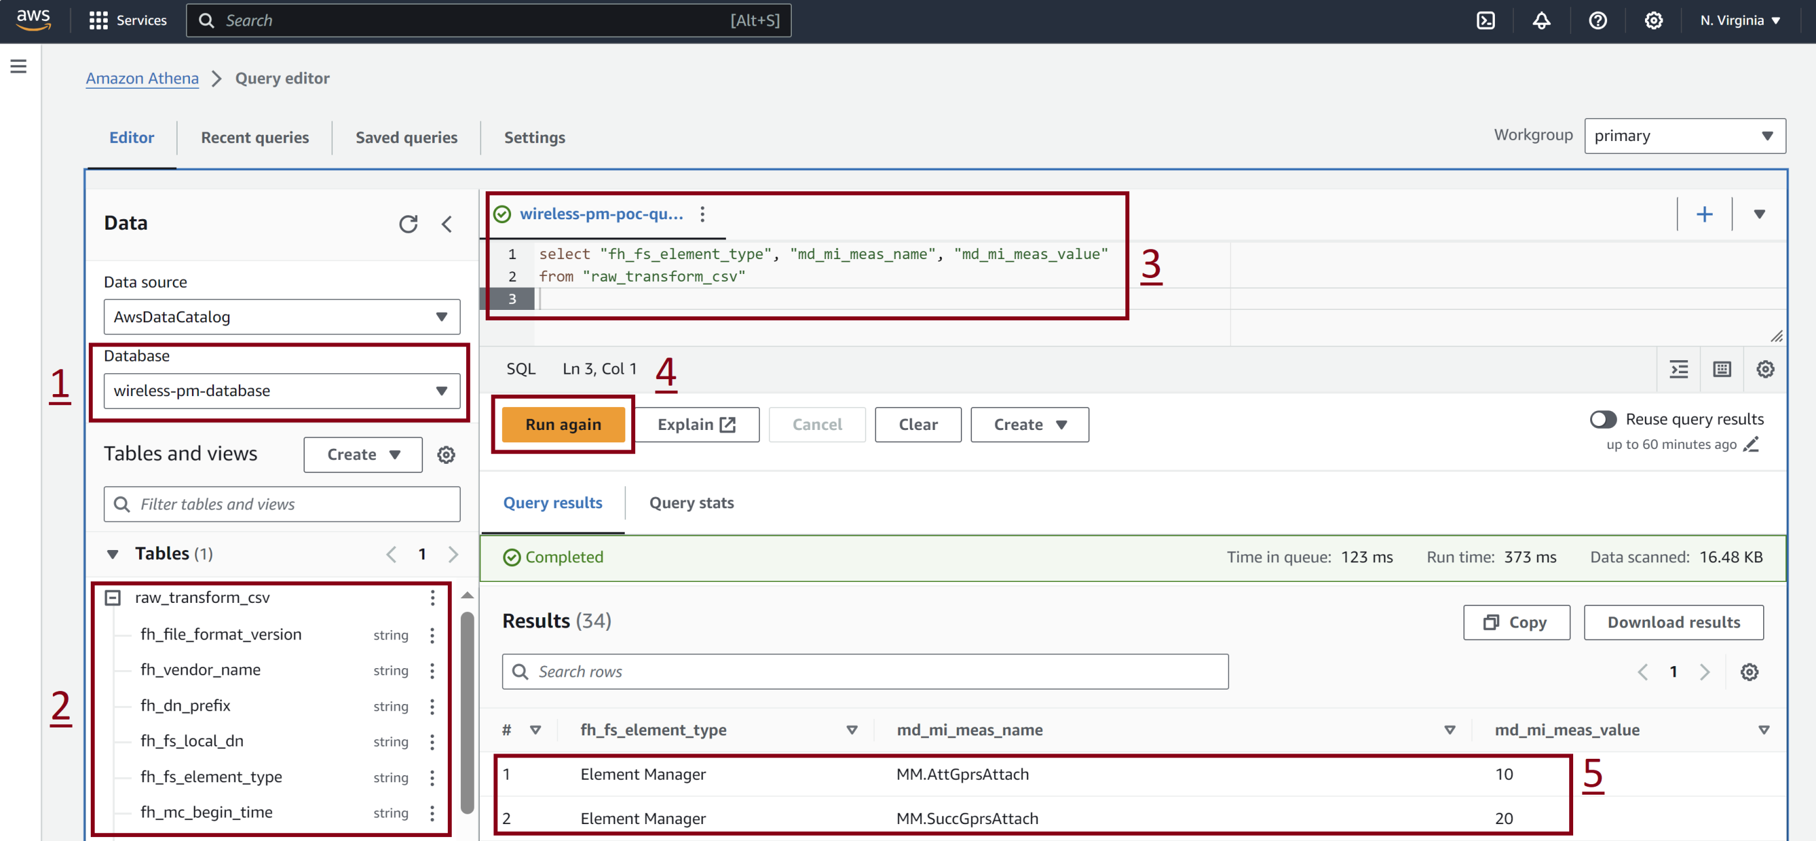
5. Run a Query

Slide 15
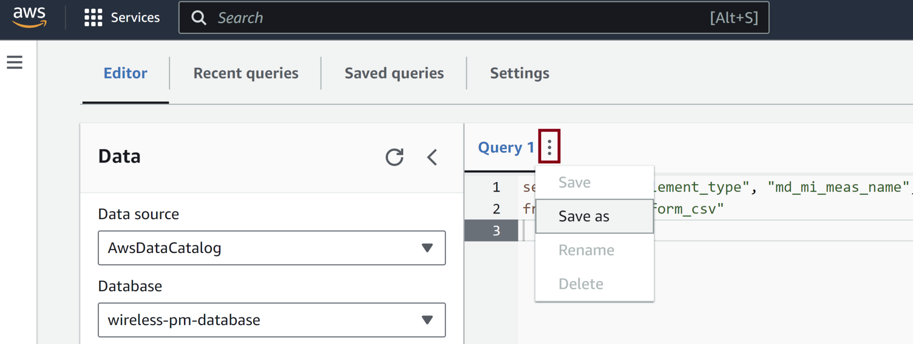
6. Save Query

Slide 16

Thank You & See You Again

